Slide 1
TECH-EDUCATION 2010
Athens, May 20th, 2010
Multicultural Interdisciplinary Handbook (MIH):
Tools for Learning History and Geography
in a Multicultural and ICT Perspective
Valentina Zangrando, Francisco José García Peñalvo,
and Antonio Miguel Seoane Pardo
Universidad de Salamanca, Grupo de Investigación en InterAcción y eLearning

Slide 2
Participants
Universidad de Salamanca (Spain)
Pädagogische Hochschule Tirol (Austria)
Hafelekar Unternehmensberatung Schober GmbH - Innsbruck (Austria)
Institut Universitaire de Formation des Maîtres - Créteil (France)
University of Augsburg (Germany)
University of Siegen (Germany)
Università Ca' Foscari di Venezia (Italy)
Społeczna Wyższa Szkoła Przedsiębiorczości i Zarządzania (Poland)

Slide 3
Project Overview
The aim of this Project is to build and share a set of tools that includes a HandBook, Digital Modules and a Teacher Training Course.
They will offer a structured path through European Contemporary History and Geography where the countries concerned will be those of the Project partners.

Slide 4
Project Objectives
Further the development of a common European identity by having schools participate in the culture of other countries using their languages and their collective symbolic imagery;
Contribute to the creation of a new generation of school HandBook and ICT-based contents that can support teachers involved in CLIL experiences, or who are simply interested in them;
Implement digital educational contents in schools.

Slide 5
Project main results
A HandBook and Digital Materials, that deal with a choice of historical and geographical topics, selected among those that have had an important impact in the national imagery in the last two centuries. The final version of HANDBOOK and Digital Modules will be available in all the languages of the partner countries.
A Teacher Training Course addressed to both future and in – service teachers. The training develops the topics dealt by the HandBook and explains its methodology and issues.

Slide 6
Impact
Immediate beneficiaries, who will also be involved in evaluation and pilot testing, are:
Future teachers of Languages, History and Geography enrolled with the partner institutions.
Teachers currently in service in associated schools as well as those that can be reached in the course programme.

Slide 7
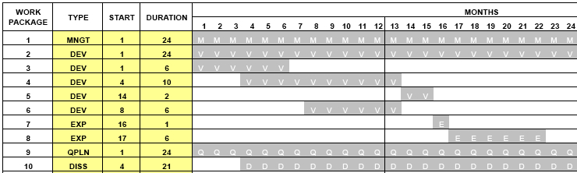
Project life
Timetable
October 1st 2009 – September 30th 2011
WP1 Management WP6 Design of the Teacher Training Course
WP2 Technic and Design WP7 Teacher Training Pilot Course (Exp)
WP3 Baseline Study WP8 HB and Digital Modules Pilot (Exp)
WP4 Handbook and Digital Modules WP9 Quality Management
WP5 Translation and Edition of HB and WP10 Dissemination
Storyboard

Slide 8
Project Steps
Define key topics and methodology based on comparative studies and collaborative engagement.
Draft initial version of the handbook and implement quality evaluation.
Write the final version of the handbook in English and in the five languages of the partnership.
Develop a storyboard of the modules and produce the podcasts.
Design the teacher-training course.
Run a pilot study of the toolset and related quality evaluation.

Slide 9
Workpackages
WorkPackages (i)
Workpackage 1: Project Management
Universidad de Salamanca
Workpackage 2: Technique and Design
Universidad de Salamanca
Workpackage 3: Baseline Study
Università Ca’ Foscari di Venezia
Workpackage 4: Handbook and Digital Modules
Institut Universitaire de Formation des Maîtres - Créteil
Workpackage 5: Translation and Edition of Handbook and Storyboard
Społeczna Wyższa Szkoła Przedsiębiorczości i Zarządzania

Slide 10
Workpackages
WorkPackages (ii)
Workpackage 6: Design of the Teacher Training Course
Pädagogische Hoschule Tirol
Workpackage 7: Teacher Training Pilot Course
University of Siegen
Workpackage 8: Handbook and Digital Modules Pilot
University of Augsburg
Workpackage 9: Quality Management - Monitoring and Evaluation
Hafelekar Unternehmensberatung Schober GmbH - Innsbruck
Workpackage 10: Dissemination, Valorisation and Sustainability
Hafelekar Unternehmensberatung Schober GmbH - Innsbruck

Slide 11
MULTICULTURALITY
Learning Object Model
LearningObject
(A didactic goal with a cultural orientation)
EUROPEAN DIMENSION
LearningObject
(A didactic goal with a cultural orientation)
LearningObject
(A unit or a topic)
LearningObject
(A unit or a topic)
+
LearningObject
(A unit or a topic)
MIH
Handbook
LearningObject
(A didactic goal with a cultural orientation)
+
DIDACTICS
Methodological guidelines
+
RESOURCES
Basic LearningObject
(a video, an audio, a text, a table, an animation, etc.)
Basic LearningObject
(a video, an audio, a text, a table, an animation, etc.)

Slide 12
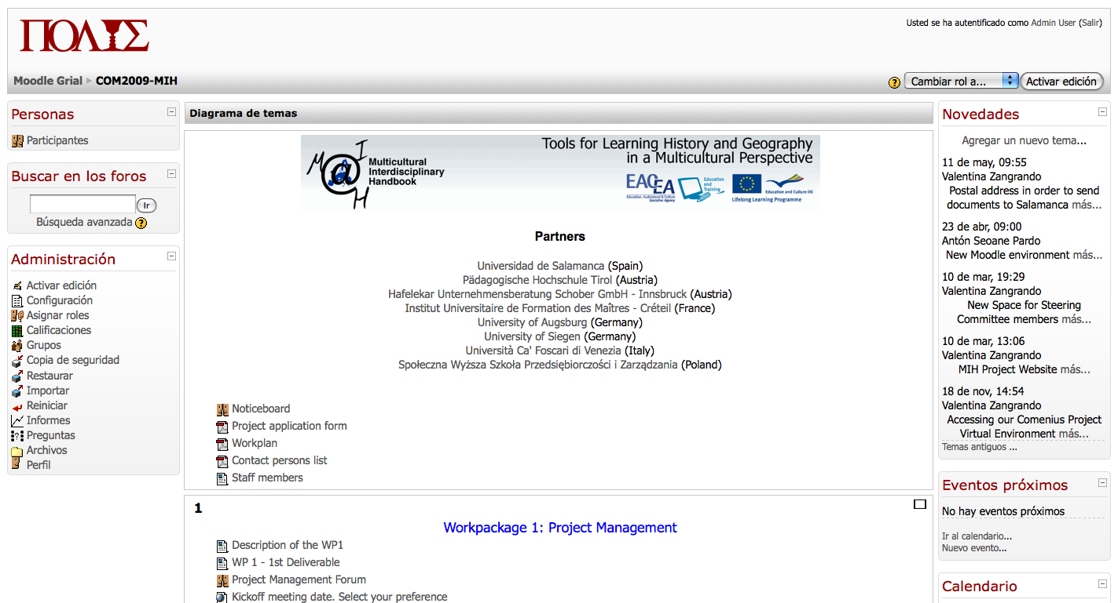
CommunicationStrategies
Internal Communication and Working Environment

Slide 13
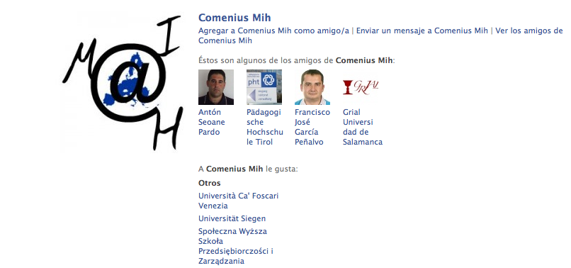
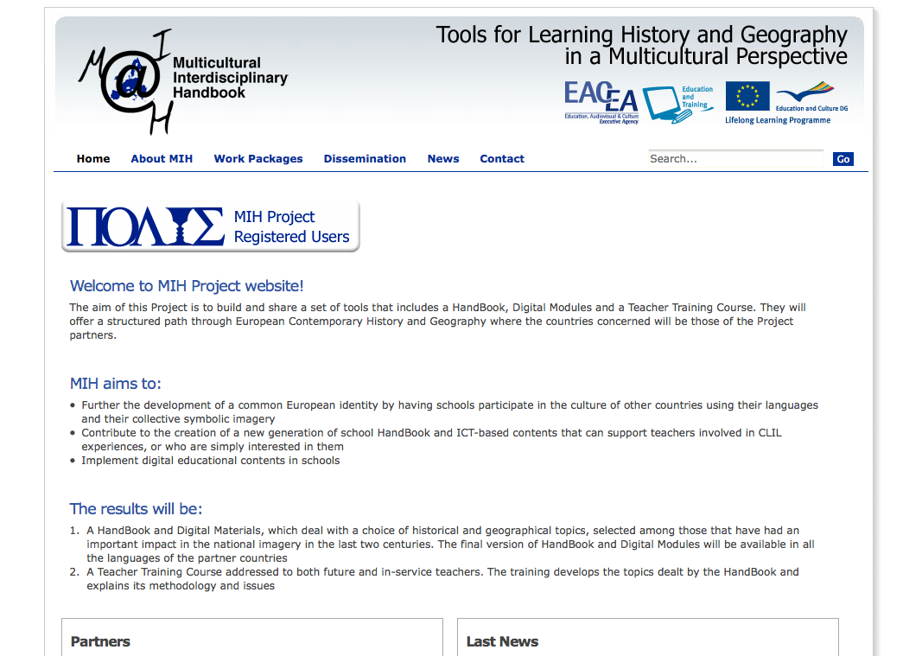
CommunicationStrategies
External Communication (website and collaborative)

Slide 14
Conclusions
Although the Project is now beginning its researching activities, we were able to confirm the claim for some kind of new learning tools and methodologies for History and Geography with a multicultural, CLIL and ICT approach.
We expect to explore and experience new methods and to find a very interesting approach to renew some learning contents regarding History and Geography with these perspectives: multiculturality, CLIL, ICT.

Slide 15
Contact
http://www.mihproject.eu
http://twitter.com/mihproject
http://www.facebook.com/people/Comenius-Mih/100000911645603

Slide 16
Acknowledgements
The project MIH (502461-LLP-1-2009-1-ES-COMENIUS-CMP) has been funded with support from the European Commission. This publication reflects the views only of the authors, and the Commission cannot be held responsible for any use which may be made of the information contained therein

Slide 17
TECH-EDUCATION 2010
Athens, May 20th, 2010
Multicultural Interdisciplinary Handbook (MIH):
Tools for Learning History and Geography
in a Multicultural and ICT Perspective
Valentina Zangrando, Francisco José García Peñalvo,
and Antonio Miguel Seoane Pardo
Universidad de Salamanca, Grupo de Investigación en InterAcción y eLearning

