Slide 1

Main Rearch Lines and Results
Miguel Ángel Conde González mconde@usal.es
Notes:
Hello my name is Miguel Ángel Conde González, I’m a reseracher of Grial Research group and I’m here to talk about some of the main research lines of the group and some of the results that this research generates

Slide 2
Outline
Introduction
Projects and Results
Conclusions
Notes:
Here we have a litte outline. First we have an Introduction in which we could see how learning processes are changing with the technologie, after it we will talk about some of our main projects and results and finally we have some conclussions

Slide 3
Introduction
Projects and Results
Conclusions

Slide 4
Introduction (i)
GRIAL has several reseach lines opened
Each one of the projects developed must have results
Not always results are products
  Know how
  Reports
  Articles
  Awards
Notes:
GRIAL has several research lines opened as you have seen in previous presentation, here we talk about them from a point of view centered on the results. Sometimes these results could be products, but also they could be knk how, reports, articles in conferences, awards and other things

Slide 5
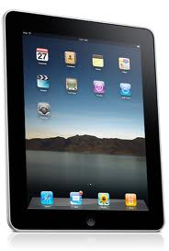

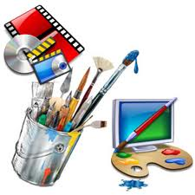
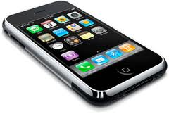

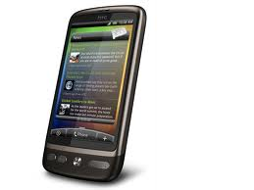
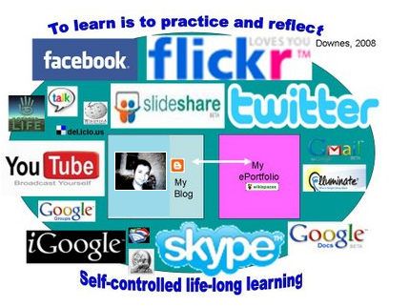

Introduction (ii)
Different research lines = different results and products
Notes:
We have different research lines on mobile devices, Moodle developments, personal learning environments, elearning consulting, contents definition and so on, but what are our results

Slide 6
Introduction (and iii)
Some main lines of results
  Contents adaptation
  Mobile
  Moodle development
  PLE
Notes:
In this presentation we will be centered on four main lines of results. Content adaptaiton, Moodle Development, Mobile and PLE

Slide 7
Introduction
Projects and Results
Conclusions

Slide 8


Projects & Results (i)
Contents Adaptation to Mobile Devices
  eLearning evolves with the evolution of new technologies
  New contexts, new information sources, new devices
Notes:
One of our main research lines was contents adaptation to mobile devices. This is very easy to explain. eLearning must evolved linked to new technologies, we have to incorporate new technologies in learning processes and these defines new application contexts, new information sources, new realities and so on. Changes give us new chances to improve eLearning.

Slide 9
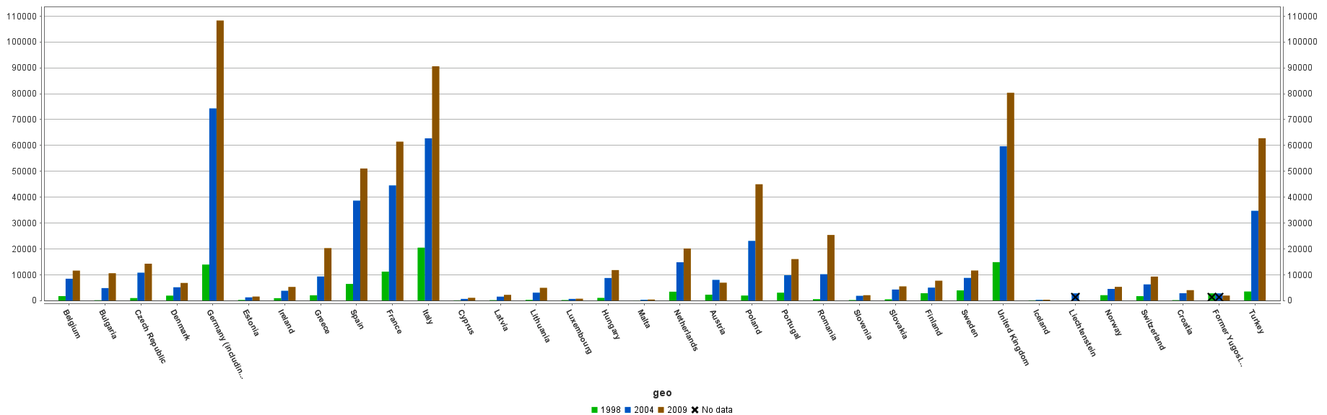
Projects & Results (ii)
Content Adaptation System
  Mobile learning supporting but no replacing eLearning
  Widely Acepted Access anywhere
Notes:
Content Adaptation System could be consider as a Mobile learning system. TMobile learning, and must be consider as a new way to support eLearning and not as way to replace it. But why to consider mobile devices and content adaptation. The main reason is the expansion and aceptation of these technologies today and the necesity of access to learning contents anywhere. In the image we could see the number of mobile suscriptions group by countries from 1998 till 2009, in sonme countries this number has grown exponentially

Slide 10
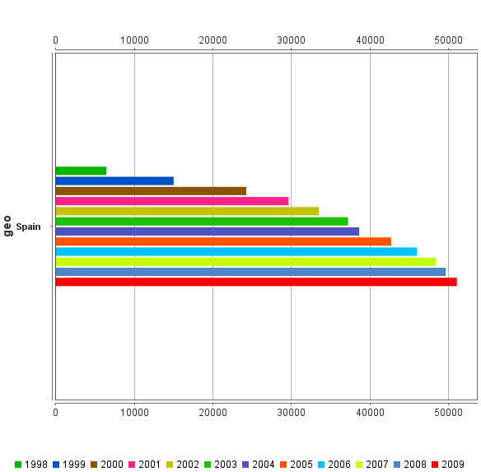
Projects & Results (iii)

Slide 11

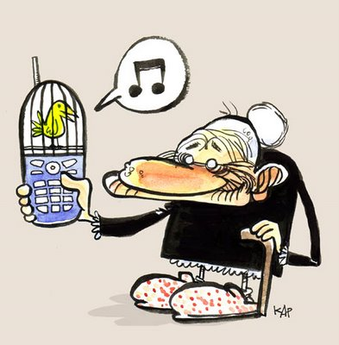
Projects & Results (v)
All kinds of users
Notes:
We could have very different users but all of them use mobile devices although in differente ways. For example, a teenager could use a mobile device to access to the internet, write twets, send sms and so on and an ancient could use it to talk with their relatives

Slide 12







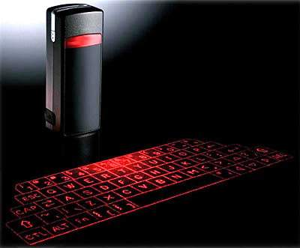
Projects & Results (vi)
Other factors
Notes:
Connections are cheaper
Technological backdraws have been solved and so on

Slide 13
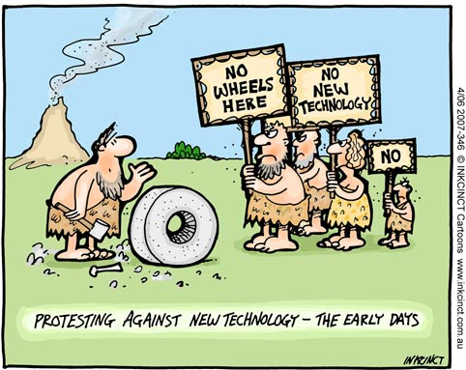
Projects & Results (vii)
Problems
Notes:
Also we have other problems, for example the resistance to change

Slide 14

Projects & Results (viii)
Problems
  Need of technological adaptation
  Need of Pedagogical adaptation

Slide 15
Projects & Results (ix)
Adaptation system
  What to adapt
  How to adapt
Adaptation of content from LMS
  What kind of resources
  What kind of activities
    Consider the interaction with mobile device
    Consider the interaction with LMS

Slide 16
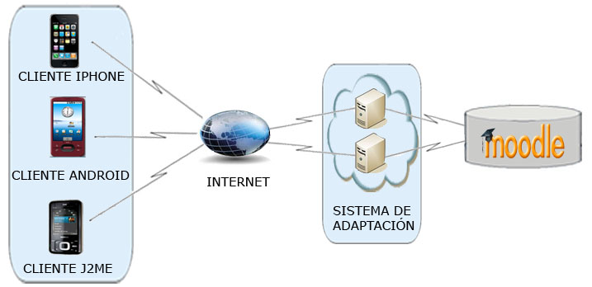
Projects & Results (x)
2 Final Year Project to develop CLAYMOBILE
Notes:
What we have developed is a system that adapts content from moodle to different kind of mobile devices. Only content and navigation will be adapted, we are not considering activities and interaction

Slide 17
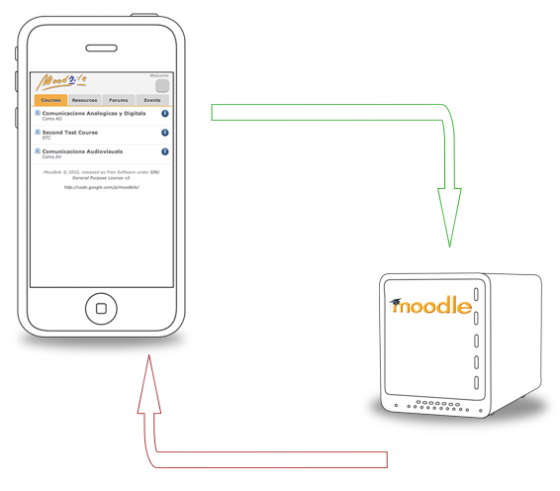
Projects & Results (xi)
Other mLearning iniciatives
  Moodbile (http://code.google.com/p/moodbile/)
Notes:
Moodbile is a project currently being developed. This is a client able to obtain content and interaction from moodle and represent it in a mobile device. This client allow offline work

Slide 18
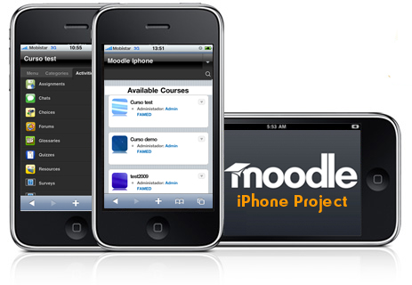
Projects &Results (xii)
Other mLearning Iniciatives
  Moodle4iPhone (http://iphone.moodle.com.au/)
Notes:
A project between different instituions to define a Moodle mobile client for iPhone.

Slide 19
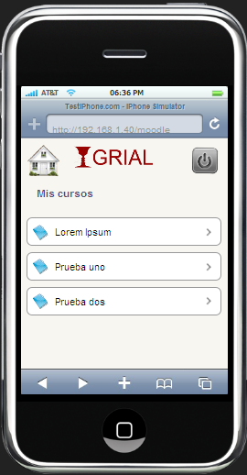
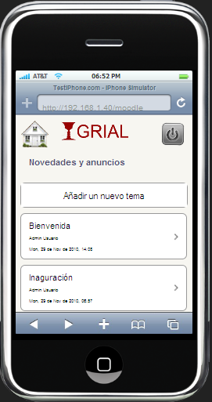
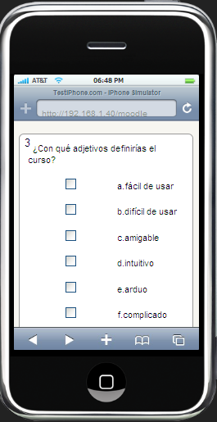
Projects &Results (xiii)
Mobile Project for the Escuela de Administración Pública de Castilla y León (ECLAP)
Notes:
Here has been define another view layer over Moodle, in a way that those users who accesses to Moodle with a mobile could see it properly and those who enters into Moodle with a web browser could see the same content.
Pilot for mobile courses
Redefine Moodle visualization model

Slide 20
Projects & Results (xiv)
PLE
  Learning processes are continously evolving
  Not only technological changes
  eLearning as one of these evolutions
    Great acceptation but less benefits than expected
    LMS are commonly used but without expected improvements
      LMS a space to publish courses
      Restricted to a period of time
      Focused on the course
      Ignoring new initiatives and trends
Notes:
When we talk about Learning processes we also have to think in changes. Learning processes are continously evolving. This evoulution is related to technological, sociological and pedagogical new trends. may be due to new sociological or technological trends.
The eLearning is one of those evolutions, and is almost completely assimilated into the educational environments. This learning model has relied on technology without obtaining, in many cases, the expected benefit, as if it has occurred in other areas. Despite this eLearning has experienced an extraordinary growth over the last years, learning paradigms; technological solutions, methods and pedagogical approaches have been developed, discarded and adopted. We have reached a point in time when most of learning institutions have adopted the use of Learning Management System (LMS). LMS have reached the balance to meet the structure and (traditional) ways of schools, universities and other educational institutions. These systems provide students and teachers a set of tools for improving learning processes and managing them. However, the LMS have not achieved the expected improvements due to: 1) The tools provided are not used properly and often are used as mere spaces to publish courses [2], 2) The LMS restrict opportunities to collaborate on student learning and promote social constructivism not limited to a period of time (i.e. academic year) [3], 3) They are focused on the course and the institution rather than the student and their needs [4].
Besides this should be noted that online learning does not end with the LMS, but there are plenty of online tools to supplement and improve it.
Therefore, new applications must be taken into account, such as the search applications, news applications, location-enabled applications, content repositories, forums, blogs, calendars, online games, virtual worlds, etc. That is, the new initiatives arising from Web 2.0 [5].
Given this situation will be necessary to evolve the LMS to its integration with contexts that include new technological trends, to provide social characteristics and be focused on the student, these contexts are personalized learning environments (Personal Learning Environments, PLE) [6] and also are considered as Open Learning Environments. This will be the main objective of the present project.
Throughout this article firstly PLE and its relationship with 2.0. tools will be described. Later we talk about a possible deployment by using service-oriented architectures. Finally the proposed architecture will be exposed.

Slide 21

Projects & Results (xv)
LMS are mature enough but must evolve to avoid extinction
New learning trends as asteroids
Notes:
As Charles Severance commented, Learning Management Systems are mature enough. Most learning institutions and companies have their LMS. Although almost always only some funcionalities are being used. If those LMS are not able evolve they will be extinguished. New learning trends could be considered as asteroids and interoperability is required to save learning platforms.

Slide 22

Projects & Results (xvi)
Open the Walled Garden
Notes:
LMS are widespread. The learning institutions provide to the teachers and learners a set of online learning tools embedded into the LMS by default. The LMS is also used as a channel to gather other services like access to portfolios and content repositories. But outside of the LMS there are also plenty of online tools that can be useful sources of information, ways of collaborating and sharing: Search, News, Maps, Documents and Spreadsheets, Public forums, Calendar, Translation, Images, Videos, Microblogging. Social networks, Bookmarking, Wave, Online Games, 3d Virtual worlds...
All these services are already being used for educational purposes, but only by advanced users. And usually the usage of these online tools is not integrated within the scope of what we could refer as "virtual classroom". Because is happening outside of the radar of the learning institutions and sometimes even the teacher.
Let's consider this -not so fictional- scenario: a subgroup of students of a class are using tools like Instant Messaging, Wikis, Wave or participating in a Social Networking site, while and sometimes for doing homework. The students engaged in the usage of all these online tools might get better grades or not - some studies say they most likely will -, but they will also learn important skills and competences on taking advantage of information technologies to access, share information and collaborate with others to do so. But their teacher may not know about it, because all the information (feedback) he/she receives is what appears on the LMS's course's logs, and all the tools he/she is aware are the ones bundled in the LMS. Sometimes this kind of behavior is empowered by the teacher.
Taking this into account, the integration between LMS and Web 2.0 trends will be very necessary and very important. Every day becomes more essential developing learning to the trends related to Web 2.0. Education must be supplemented by new applications, tools and paradigms that lead to what is called eLearning 2.0 [7]. This new trend in learning requires tools that facilitate: 1) changes in the ways of interacting socializing the learning; 2) access to tools considering the new performers in learning, natives and digitals immigrants; 3) support to educational trends such as learning throughout life or informal learning, students mobility and so on, related to the Bolonia process; 4) the student-centered learning.

Slide 23
Projects & Results (xvii)
Are LMS the only online learning Tool out there
Are LMS in the center of the learning innovation discussion on the web
Looks like Web 2.0 has survived its own hype, and is thriving as a concept of online activity
Notes:
LMS are widespread. The learning institutions provide to the teachers and learners a set of online learning tools embedded into the LMS by default. The LMS is also used as a channel to gather other services like access to portfolios and content repositories. But outside of the LMS there are also plenty of online tools that can be useful sources of information, ways of collaborating and sharing: Search, News, Maps, Documents and Spreadsheets, Public forums, Calendar, Translation, Images, Videos, Microblogging. Social networks, Bookmarking, Wave, Online Games, 3d Virtual worlds...
All these services are already being used for educational purposes, but only by advanced users. And usually the usage of these online tools is not integrated within the scope of what we could refer as "virtual classroom". Because is happening outside of the radar of the learning institutions and sometimes even the teacher.
Let's consider this -not so fictional- scenario: a subgroup of students of a class are using tools like Instant Messaging, Wikis, Wave or participating in a Social Networking site, while and sometimes for doing homework. The students engaged in the usage of all these online tools might get better grades or not - some studies say they most likely will -, but they will also learn important skills and competences on taking advantage of information technologies to access, share information and collaborate with others to do so. But their teacher may not know about it, because all the information (feedback) he/she receives is what appears on the LMS's course's logs, and all the tools he/she is aware are the ones bundled in the LMS. Sometimes this kind of behavior is empowered by the teacher.
Taking this into account, the integration between LMS and Web 2.0 trends will be very necessary and very important. Every day becomes more essential developing learning to the trends related to Web 2.0. Education must be supplemented by new applications, tools and paradigms that lead to what is called eLearning 2.0 [7]. This new trend in learning requires tools that facilitate: 1) changes in the ways of interacting socializing the learning; 2) access to tools considering the new performers in learning, natives and digitals immigrants; 3) support to educational trends such as learning throughout life or informal learning, students mobility and so on, related to the Bolonia process; 4) the student-centered learning.

Slide 24
Projects & Results (xviii)
New spaces
  Twitter, Buzz and other microblogging
  Platforms
  Maps
  Video Streaming (Youtube , Vimeo, etc)
  Social Networks (Ning, xing, Mahara)
  Wikipedia and other sources
  Wolfram Alpha
  Google docs (and clones)
  Google wave
  ….
Other contexts
  Other ways to access the web
  Game consoles
  Mobile Devices
Notes:
LMS are widespread. The learning institutions provide to the teachers and learners a set of online learning tools embedded into the LMS by default. The LMS is also used as a channel to gather other services like access to portfolios and content repositories. But outside of the LMS there are also plenty of online tools that can be useful sources of information, ways of collaborating and sharing: Search, News, Maps, Documents and Spreadsheets, Public forums, Calendar, Translation, Images, Videos, Microblogging. Social networks, Bookmarking, Wave, Online Games, 3d Virtual worlds...

Slide 25
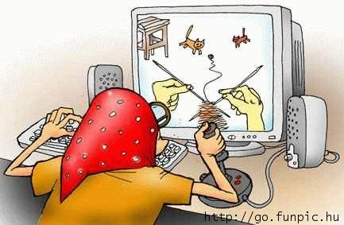


Projects & Results (xix)
Services used for educational purposes outside the radar of learning institutions and the context of a LMS
Integration between LMS and new trends and technology is necessary evolving towards what is known as eLearning 2.0
This integration must consider
Notes:
All these services are already being used for educational purposes, but only by advanced users. And usually the usage of these online tools is not integrated within the scope of what we could refer as "virtual classroom". Because is happening outside of the radar of the learning institutions and sometimes even the teacher.
Taking this into account, the integration between LMS and Web 2.0 trends will be very necessary and very important. Every day becomes more essential developing learning to the trends related to Web 2.0. Education must be supplemented by new applications, tools and paradigms that lead to what is called eLearning 2.0 [7]. This new trend in learning requires tools that facilitate: 1) changes in the ways of interacting socializing the learning; 2) access to tools considering the new performers in learning, natives and digitals immigrants; 3) support to educational trends such as learning throughout life or informal learning, students mobility and so on, related to the Bolonia process; 4) the student-centered learning.

Slide 26
Projects & Results (XX)
PLE
  Student-centered contexts that integrate any tool, service, content involved in eLearning process
  Some limits must be necessary in the means used by the students (iPLE)
  New trends and technologies provide benefits but also new problems
    Improvisation in the use of Web 2.0 tools
    Technical problems and pedagogical problems (it’s easy to copy and not to create)
    Lack of support from LMS
  PLE can solve these problems
Notes:
As a proposal to solve all these needs are the PLE, which according to Wilson [6], are defined as learning student-centered contexts that integrate any tool, service, content, evidence and person involved in e-learning process. This way the responsibility of the learning is given to the student, which benefits itself and its formative process [8]. However, some limits could be necessary (generally derived from an institution concerned about the formality of their teaching/learning process) in the means used by the student to define its learning. Hence it’s necessary that PLE can be constructed by integrating tools 2.0 and LMS [9].
Incorporating Web 2.0 applications into learning processes involves bringing in new styles of communication, new roles, new ways of intervention, new scenarios, a wide range of activities, generally, involves opening a series of educational challenges [10]. Through these trends, students are no longer passive subjects of learning to become active students in classes, with no restrictions, being able to use things like Google, Facebook, Twitter, etc. to support learning processes; they can use digital devices such as computers, mobile phones, mp3, recorders and so on to improve the learning.
The potential of these tools is enormous, as evidenced by experiences such as Jekins [11], Downes [4], and it’s increasingly expanding in the different educational environments [12]. Despite all that power is necessary to take into account a number of problems which have arisen through the application of these tools: 1) The improvisation in the use of 2.0 tools and customization of student-centered learning can lead to the wrong idea that the use of this tools into learning should not be planned, this is not correct, they should be estimated, validated and evaluated according to different criteria [13]; 2) Among the problems hampering the full educational utilization of Web 2.0 should be mentioned some technological problems – insufficient bandwidth and lack of access to computers in schools and students’ homes – and other pedagogical issues where the biggest challenge is that students don’t create products and prefer to “copy and learn”, students assessment procedures are not formatives and do not “mix” means. [14]; 3) Lack of support from LMS to the use of these kind of tools.

Slide 27
Projects & Results (xxi)
How to define a PLE
  Start a solution from scratch
    Most initiatives only integrates different 2.0 tools in a container
  Based the new system in a existing LMS
    Requires considering what to export and what to import in the LMS
    Institution necessities must be taken into account
  SOA Approach as a technological solution
Notes:
PLE can solve many of these problems and, after determining their use, you must think how to deal with the system definition. Maybe the first question should be whether start a solution from scratch or based it on another LMS. Considering existing initiatives is convenient in this regard, as well as the benefits that would have either decision. In this sense there are some studies and experiences such as [15]:
Analysis concerning the adequacy of integrating 2.0 applications in continuing training context, as well as in web application hybrid (mash-ups).
Definition of PLE from an hybrid approach, describing a customizable Web portal as a base of PLE in which would be aggregated different Web tools interconnected from different contexts, and providing an interaction language among its users.
Research of the limitations of the integration of applications derived from the exchange of information between them, the use of REST is proposed to solve them.
Design and implementation of strategies for PLEs definition.
Implementation of a institutional PLE for the University of the Basque Country, thus, a PLE where applications 2.0 which student can use are defined by the University.
RWTH Aachen University was commissioned to develop the Learning Environment Framework (PLEF) (http://eiche.informatik.rwth-aachen.de:3333/PLEF/index.jsp), a PLE service that takes care of composing a set of subservices to support the students’ activity when composing, manage, tag, annotate and share their favorite resources.
The discussed initiatives define in some cases PLE, but do not consider all areas of information. Most of them only integrate different tools 2.0 in a container, regardless of LMS information. One of them, the Basque Country University works to integrate tools in the LMS, but this integration will be through widgets and will not exist, therefore, interaction between tools and platform.
Hence, the system proposed here covers a broader spectrum of communication and do not forget in any case the LMS. Taking into account these experiences could be decided that it might be better to hold the system from scratch, taking the architecture referred to the mash-ups and the interaction languages, but should be necessary to consider the futility of reinventing the wheel again. To define a PLE should not assume to discard the functionalities of the LMS, these functionalities can enrich student learning, and 2.0 components integrated in the learning platform would enhance exponentially the possibilities of learning in institutions. Neither should be neglected the acceptance of certain LMS such as Moodle in Spain (and elsewhere in the world).
Once the base has been established, the conversion of LMS into a PLE begins. At this point, the two possibilities of PLE that this project offers should be considered. First, the need to export information from the LMS to a PLE, i.e., the export system of educational portable components, while on the other hand would be the integration of tools 2.0 in the LMS in order to redefine them as iPLE (integrated PLE or institutional PLE, depending on the approach).
Insomuch as the export of information of the platform, you must determine what to import, how to import it and how to display the information.
With regard to what to export, pedagogical criteria must be met considering what information is most critical, which activities are more representatives and enrich the personal student environment, in addition to what information is more appreciated by the students.
Regarding to how to export is considered the usage of a service-oriented architecture (SOA - Service Oriented Architecture). It allows, so, the integration of the system regardless of the technology that is implemented, the scalability is improved, more flexible systems are defined, easier to maintain and more resistant to change. It also facilitates the interconnection of heterogeneous contexts such as LMS and mobile devices.

Slide 28
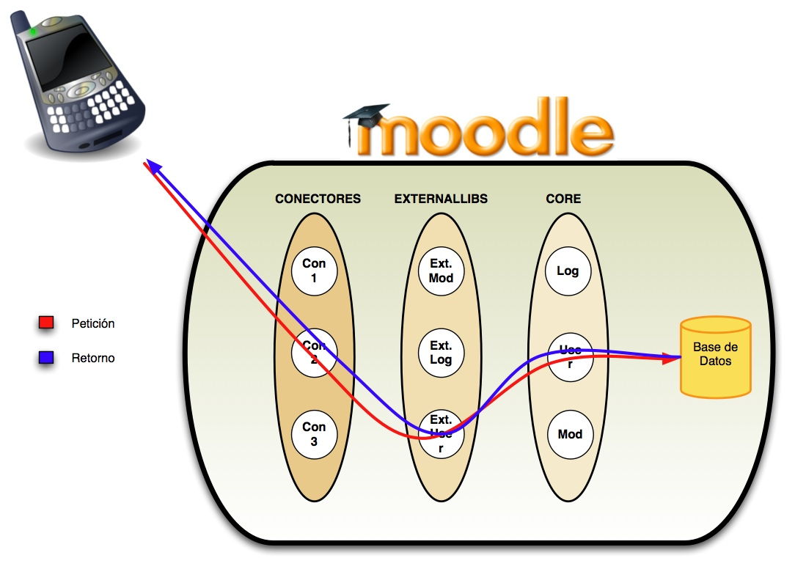
Projects & Results (xxii)
Need to apply SOA to Moodle

Slide 29
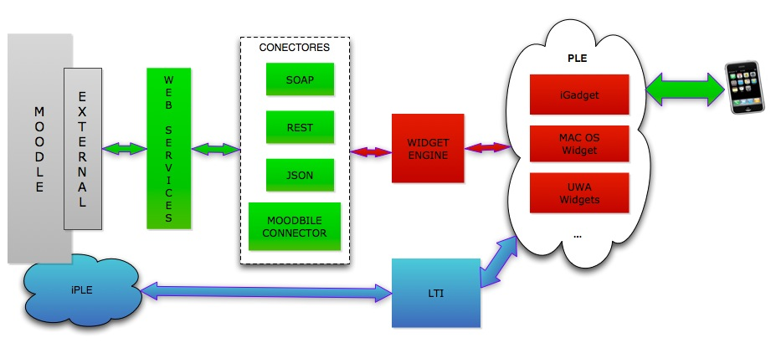
Projects & Results (xxiii)
How to use it to define a PLE

Slide 30
Projects & Results
(and xxiv)
Other technological projects
  Semantic Web applied to learning environments by using layers (http://layers.com/)
  Define learning apps store for PLE
  ….

Slide 31
Projects & Results
(and xxiv)
Other technological projects
  Semantic Web applied to learning environments by using layers (http://layers.com/)
  Define learning apps store for PLE
  ….

Slide 32
Introduction
Projects and Results
Conclusions

Slide 33
Conclusions
Several types of developments with different results
  Mobile results
    Addaptation System, ECLAP, Moodbile, iPhone, Moodle4iPhone
  PLE results
    New environments
    Net tools
    The user as the center
  Moodle Development
  And so on…

Slide 34
Main Rearch Lines and Results
Miguel Ángel Conde González mconde@usal.es
Notes:
Hello my name is Miguel Ángel Conde González, I’m a reseracher of Grial Research group and I’m here to talk about some of the main research lines of the group and some of the results that this research generates

