Slide 1

Workplace Learning Analytics
Adolfo Ruiz-Calleja
28th June, 2016

Slide 2
Goals
Rise awareness about the Learning Layers project
  Formal/Informal learning
  Learning outside the classroom
Introduce the Three Learning Metaphors
Reflect how Learning Analytics can be applied in workplace learning
First exercise where you work in groups

Slide 3
Agenda
Let me introduce myself
Introduction: Learning with technology at Learning Layers project
Three learning metaphors
EXERCISE IN GROUPS
OVERALL DISCUSSION

Slide 4
Agenda
Let me introduce myself
Introduction: Learning with technology at Learning Layers project
Three learning metaphors
EXERCISE IN GROUPS
OVERALL DISCUSSION

Slide 5
Let me introduce myself
Adolfo Ruiz Calleja
2007: Telecommunication Engineer
2007-2008: Master in Logic and Philosophy of Science
2009-2013: PhD student at Valladolid University (Spain)
2013-2014: Freelance
2014 – now: Researcher at Tallinn University
Contact:
adolfo@tlu.ee

Slide 6
Agenda
Let me introduce myself
Introduction: Learning with technology at Learning Layers project
Three learning metaphors
EXERCISE IN GROUPS
OVERALL DISCUSSION

Slide 7
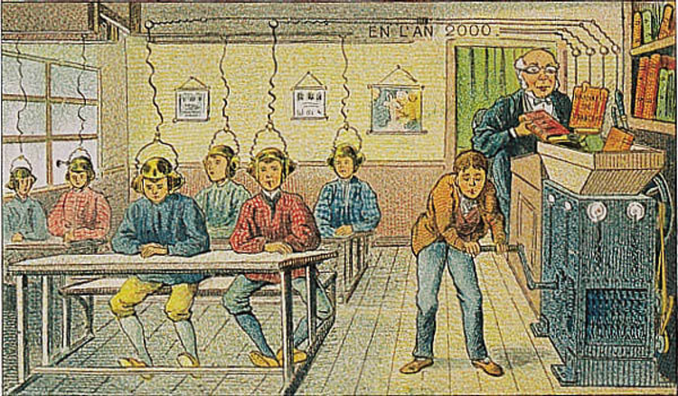
Learning from technology
Villemard, 1910: À l' École, Bibliotèque national de France
http://expositions.bnf.fr/utopie/grand/3_95b1.htm

Slide 8

Learning with technology

Slide 9
The Dilemma of Informal Learning at the Workplace
eLearning for Workplace Learning follows traditional training models
  Based on direct instruction, courses and transfer of face-to-face interaction to onscreen interaction [Kraiger 2008]
  Scales through reliance on standardized materials
However, most learning (esp. in SMEs) is informal
  Connected to work practices, multi-episodic, just-in time [Hart 2011, Kooken 2009]
  Passing on of skills between experienced workers [Attwell & Baumgartl 2011]
  Does not scale well beyond immediate context
individualized
highly effective
contextualized
motivating
does not scale
not persistent
few benefit
expensive

Slide 10
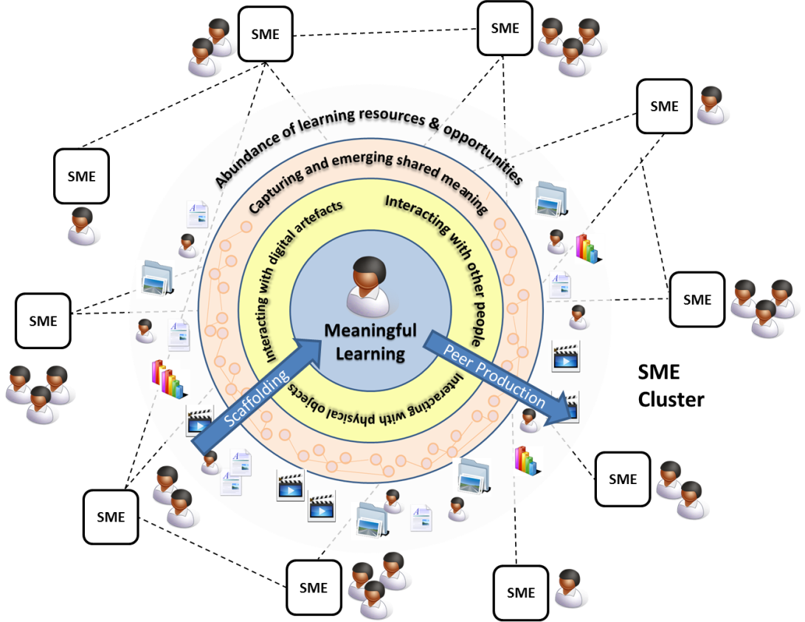
Scaling up learning at the workplace

Slide 11
Scaling Informal Learning
Looking at Learning in Work Practices
  [Eraut and Hirsch 2007, Maier 2009, Attwell 2003, Kooken et al. 2009, Collin 2006]
Unlock Peer Production
  [Schmidt et al. 2009, Maier & Schmidt 2007]
Scaffolding for Meaningful Learning
  [Ley et al. 2010, Lindstaedt et al. 2010, Siadaty et al. 2010, Pata, 2006]
Scale through Regional Clusters
  [Deitmer and Attwell 2000]

Slide 12
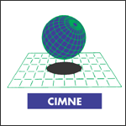





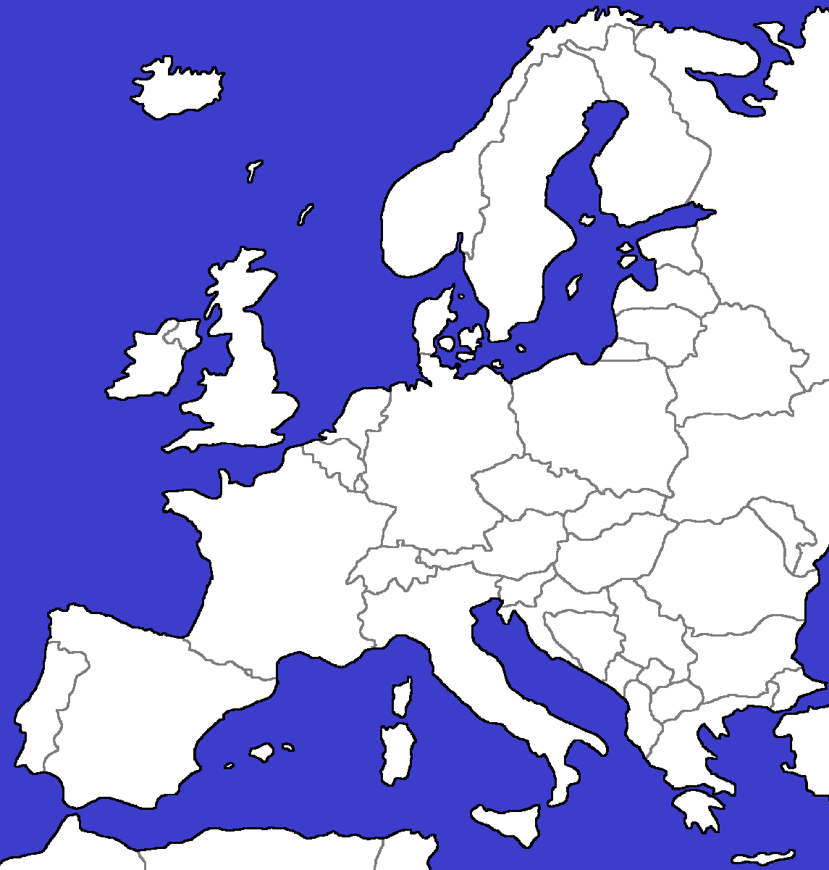









Project Coordination
Project
Consortium
Learning Technology Research
Scaling Partners
Regional Application Clusters
Health Care – Leeds
Construction &
Building – Bremen
Technology Partners
Basiskarte: digitale-europakarte.de

Slide 13
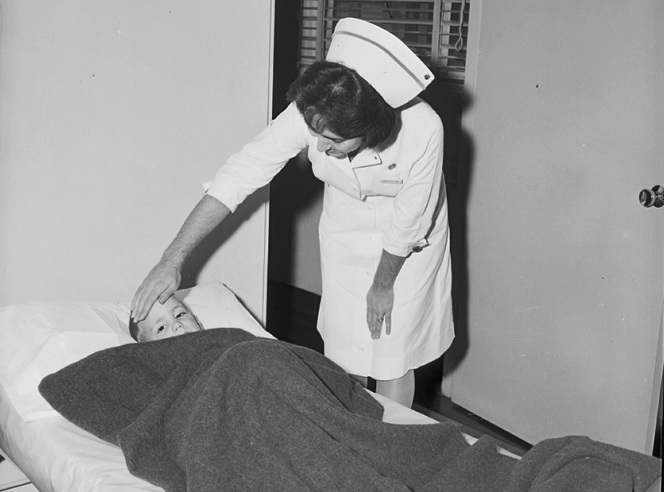
Seattle Municipal Archives
http://www.flickr.com/photos/seattlemunicipalarchives/5765842244/
http://creativecommons.org/licenses/by/2.0/legalcode

Slide 14
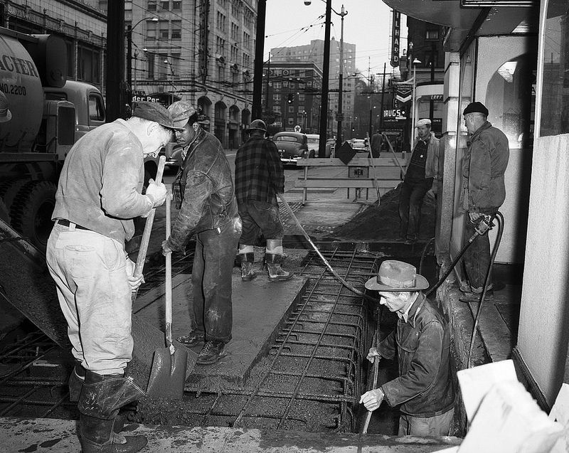
Seattle Municipal Archives
http://www.flickr.com/photos/seattlemunicipalarchives/7165372144/
http://creativecommons.org/licenses/by/2.0/legalcode

Slide 15
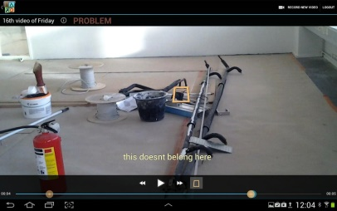

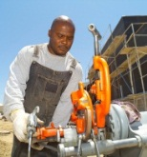
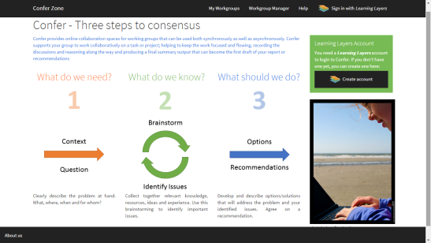
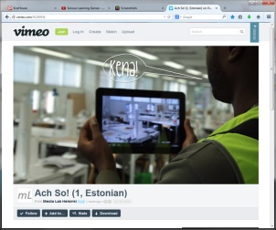




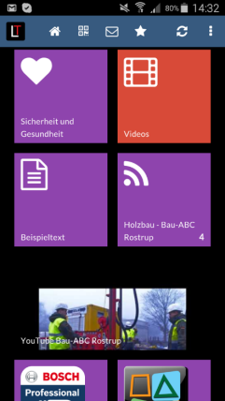
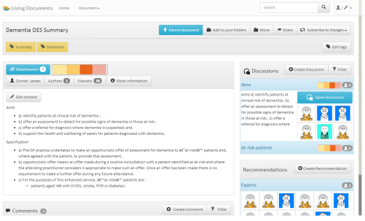
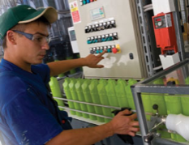
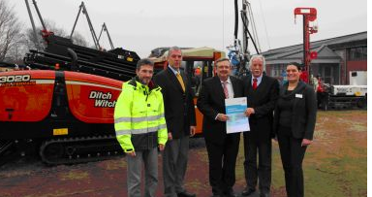
Technology for Learning in Action and Practice-based Training
Making video material available on site through QR tags
Use of video recording and annotation
Further discussion on the use of the technique in a working group
X3-PJC
X3-PVQ
Explaining the use of a new construction technique and materials on site
X3-POZ
PLC Equipment
Straw Building
Videos, questions and best practices collected in the Training Center
How To
Trainers prepare learning materials and exercises, learners engage in practice-based training

Slide 16
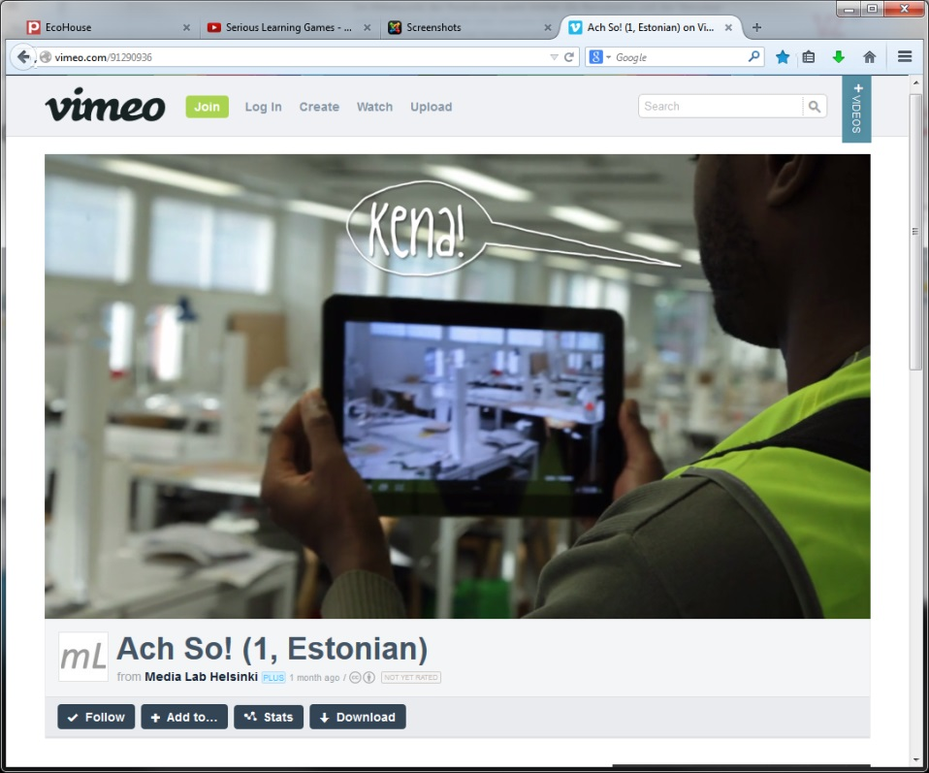
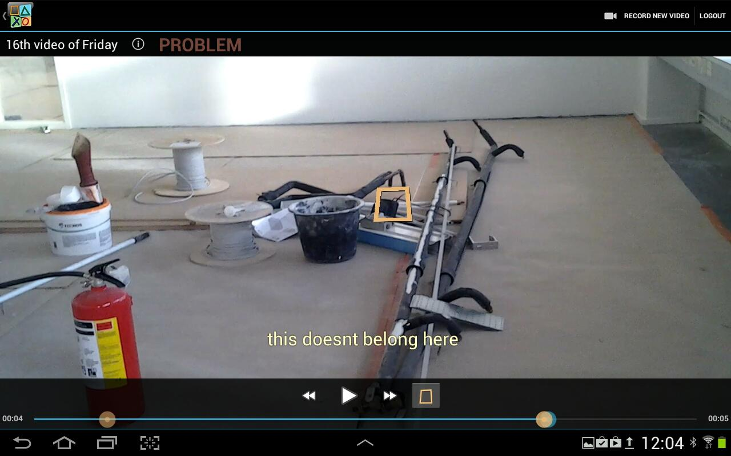
AchSo!
Youtube
Localization
Annotations

Slide 17
Agenda
Let me introduce myself
Introduction: Learning with technology at Learning Layers project
Three learning metaphors
EXERCISE IN GROUPS
OVERALL DISCUSSION

Slide 18

Three learning metaphors
Three learning metaphors as lenses for the design and analysis of learning situations (Paavola & Hakkarainen, 2005)
Conceptual tools that abstract learning theories
S. Paavola and K. Hakkarainen. “The knowledge creation metaphor–An emergent epistemological approach to learning”. Science & Education, 14(6):535–557, 2005.

Slide 19
Knowledge acquisition
MONOLOGIC LEARNING
Assume that individuals are the basic unit of learning
  Learners have to acquire, construct and represent the concepts of the domain in their internal memory
LA supports learners to acquire new knowledge or detects the knowledge they acquired
  Assess the knowledge regarding some topics
  Recommend learning resources according to explore unknown topics
Use of ontologies

Slide 20
Participation
DIALOGIC LEARNING
Learning happens by participating in cultural practices
  Learners adopt the skills that are recognized in the community
  Learning as a form of enculturation
LA understands how learners communicate and encourages social relationships
  Expert recommendations
  Visualization of social networks
Use of Social Network Analysis techniques
Discourse and content analysis

Slide 21
Knowledge creation
TRIALOGIC LEARNING
Learning as a collaborative and systematic development of common objects of activity
  Creation, uptake and development of materials and conceptual artifacts
  Learner relationships are mediated by artifacts
  Focuses on innovation
LA detects emerging topics of interest and their evolution
  How artifacts are collaboratively created in particular contexts
  Topic modeling
Folksonomies
Semantic relationships between actors and artifacts

Slide 22
Agenda
Let me introduce myself
Introduction: Learning with technology at Learning Layers project
Three learning metaphors
EXERCISE IN GROUPS
OVERALL DISCUSSION

Slide 23

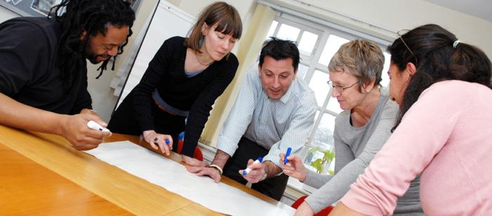
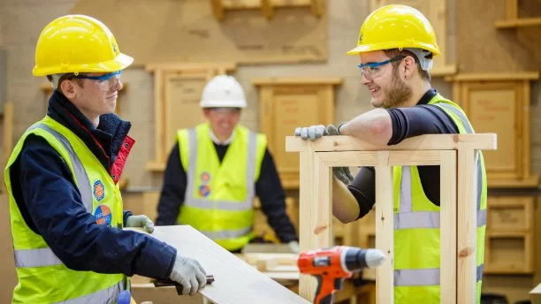


Scenarios

Slide 24
Workplace Learning Analytics
Adolfo Ruiz-Calleja
28th June, 2016

Slide 25
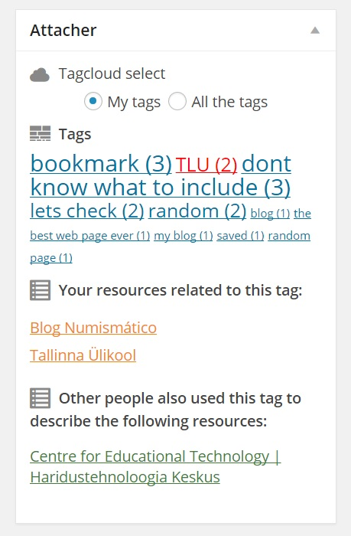
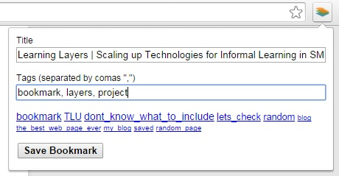
Bookmarker / Attacher
Bookmarker
Attacher

